Slide 1
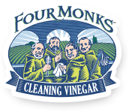
Four Monks – Green Clean Reformulation

Slide 2
Agenda
Background
Category
Strategy/Situation (Brief Overview)
Consumer Research
Next Steps
Bottle Designs
Sales Implications
Next Steps
28

Slide 3
Background
Four Monks Cleaning Vinegar currently sits in the Vinegar aisle of two current customers, WalMart and HEB as well as being distributed through C&S Wholesalers. This product is considered green clean due to its concise ingredient statement and affiliation with purity as a vinegar-based product.
The Green Clean sub-segment has grown 46% over the last five years, outpacing the multi-purpose cleaning category by 73%. This growth has largely been enabled by 5 key players: Method, Clorox, Mrs. Meyer’s, Pinalen, and Seventh Generation. Layering Four Monks consumption data in this sub-segment, Four Monks is the #8 brand in the category
Recognizing the tremendous segment growth and unmanaged product, brand, and share position, Four Monks has an opportunity to innovate within the segment with a vinegar-based product that delivers on key consumer needs: clean ingredients, efficacy, third-party certified, safe for kids and pets, pleasant scents.
28

Slide 4
Household Cleaning CATGR & Multi-Purpose Sub-CATGR
3.6% Share
+12%
+46%
Household Cleaning CATGR measures at $4.7B
Green Cleaners represent 3.6% $ Share of the overall CATGR
Multi-Purpose sub-CATGR is 46% of overall CATGR
Multi-Purpose Green Cleaners have 5.9% $ Share of the sub-CATGR
75% of Green Clean Products are Multi-Purpose
Multi-Purpose sub CATGR is outpacing the Tot CATGR by 63% over last 5 Cal Years
Total 5-year growth for Multi-Purpose sub-CATGR is +12%
CATGR has been relatively flat through last two years, +2% growth each year, respectively
Total 5-year growth for Multi-Purpose Green Cleaners is 46%, outpacing CATGR by 73%
Green Cleaners saw +22% growth in 2017
Source: Nielsen Market : Total US xAOC • Product Share Basis : HOUSEHOLD CLEANING : Cal Yrs 2013, 2014, 2015, 2016, 2017
Source: Nielsen Market : Total US xAOC • Product Share Basis : HOUSEHOLD CLEANING : Cal Yrs 2013, 2014, 2015, 2016, 2017
28

Slide 5
Sub Category || Multi-Purpose Green Cleaners
While all Markets are up, Total US Drug is growing faster than all other Markets
Description | Total US xAOC
 | $ | $ % Chg YA | Units | Units % Chg YA
SUM | BRAND HIGH
Green Cleaners | 173,338,388 | 30.0 | 44,406,175 | 30.9
METHOD | 48,461,796 | 22.1 | 12,220,368 | 22.8
CLOROX | 35,227,138 | 221.3 | 10,341,210 | 208.3
MRS. MEYER'S | 26,816,534 | 28.1 | 5,322,216 | 31.0
PINALEN | 20,631,575 | 0.5 | 6,800,557 | -4.0
SEVENTH GENERATION | 17,064,576 | 21.0 | 4,482,285 | 14.0
SIMPLE GREEN | 13,236,273 | -1.4 | 2,848,342 | 0.1
KIDS 'N' PETS | 3,017,061 | -1.8 | 620,393 | -2.3
BIOKLEEN | 1,088,785 | 2.2 | 138,012 | 1.0
EARTH FRIENDLY PRODUCTS | 944,580 | 10.9 | 297,968 | 20.2
BIO-PAK | 755,302 | -6.1 | 63,160 | -6.1
WHITE HOUSE | 708,191 | 6.0 | 265,403 | 6.6
THE HONEST CO. | 600,273 | -46.8 | 118,324 | -39.3
+30.0%
+27.7%
+30.9%
+72.6%
+23.2%
+90.5%
Multipurpose Green Clean Household Cleaners are growing across key measurable, $ and Units, and across all markets, xAOC, US Food, and US Drug
xAOC represents the largest $ market ($173MM)
US Drug is the fast growing $ market ($4MM or +73% v YA)
Method maintains 28% share of sub-category
Acquired by SC Johnson, which now controls 43% share of Green Cleaner Sub Category
Four of top 5 Green Cleaners are owned by “Big CPG”
SC Johnson, Clorox, Unilever
Clorox saw the largest growth in $ and Units v YA
Source: Nielsen Market : Total US xAOC • Product Share Basis : HOUSEHOLD CLEANING : Latest 52weeks 1/27/18
Source: Nielsen Market : Total US xAOC • Product Share Basis : HOUSEHOLD CLEANING : Latest 52weeks 1/27/18
28

Slide 6
Green Clean Growth Drivers – xAOC Base Size
Description | Total US xAOC
 | $ | $ % Chg YA | Units | Units % Chg YA
SUM | BASE SIZE
Green Cleaners | 173,338,388 | 30.0 | 44,406,175 | 30.9
28 FLUID OUNCE | 39,844,067 | 15.1 | 12,530,188 | 9.8
32 FLUID OUNCE | 34,717,097 | 38.1 | 8,924,133 | 41.8
16 FLUID OUNCE | 12,850,440 | 34.3 | 3,183,393 | 34.4
128 FLUID OUNCE | 12,848,948 | -0.3 | 2,697,383 | -3.9
24 FLUID OUNCE | 5,788,356 | 41.8 | 1,611,421 | 58.1
25 FLUID OUNCE | 5,279,103 | 22.3 | 1,005,727 | 28.0
26 FLUID OUNCE | 4,483,821 | -4.7 | 1,329,756 | 1.3
172 FLUID OUNCE | 4,236,184 | 2.7 | 475,740 | 1.5
22 FLUID OUNCE | 3,322,838 | -7.3 | 849,738 | -4.4
68 FLUID OUNCE | 2,995,354 | 101.1 | 439,522 | 87.7
Description | Total US xAOC
 | $ | $ % Chg YA | Units | Units % Chg YA
SUM | BASE SIZE
Green Cleaners | 173,338,388 | 30.0 | 44,406,175 | 30.9
70 COUNT | 13,532,702 | 316.1 | 2,616,153 | 347.2
33 COUNT | 6,012,650 | 1,455.8 | 2,392,913 | 1,405.2
35 COUNT | 2,780,575 | 12.0 | 836,373 | 9.2
30 COUNT | 1,516,190 | -27.3 | 350,718 | -27.8
10 COUNT | 755,302 | -6.1 | 63,160 | -6.1
62 COUNT | 268,285 | -35.2 | 53,475 | -30.6
140 COUNT | 127,768 |  | 14,261
1 COUNT | 42,706 | 25.2 | 3,368 | -4.5
75 COUNT | 36,486 | -82.2 | 6,856 | -80.1
40 COUNT | 4,159 | 62.4 | 577 | 7.4
$ and unit growth is seen across most SPRAY base unit sizes
Largest (%) growth seen in:
68 fl oz (101.1%)
24 fl oz (41.8%)
32 fl oz (38.1%)
Declines were seen in two fl oz base size units
22 fl oz (-7.3%)
Note: 4M base retail unit is this size
26 fl oz (-4.7%)
$ and unit growth is seen across most WIPES base unit sizes, but growth seems to vary greatly based on count
Largest (%) growth seen in:
33 Count (1,455%)
70 Count (316%)
40 Count (62.4%)
Note: 140 Count appears to be new to market so no YA
Declines were seen in two fl oz base size units
75 Count (-82%)
62 Count (-35%)
Source: Nielsen Market : Total US xAOC • Product Share Basis : HOUSEHOLD CLEANING : Latest 52weeks 1/27/18
Source: Nielsen Market : Total US xAOC • Product Share Basis : HOUSEHOLD CLEANING : Latest 52weeks 1/27/18
28

Slide 7
Green Clean Growth Drivers – Markets
xAOC, Food, and Drug markets all drive double digit growth for Multi-Purpose Green Cleaners
Multi-Purpose CATGR
Drug Channel is outpacing all channels, although only represents 2% of $ Volume for Multi-Purpose Green Cleaners
5-Year $ Volume Growth
xAOC = 46%
Food = 47%
Drug = 64%
LY $ Volume Growth
xAOC = 26%
Food = 26%
Drug = 44%
Source: Nielsen Market : Total US xAOC • Product Share Basis : HOUSEHOLD CLEANING : Cal Yrs 2013, 2014, 2015, 2016, 2017
28

Slide 8
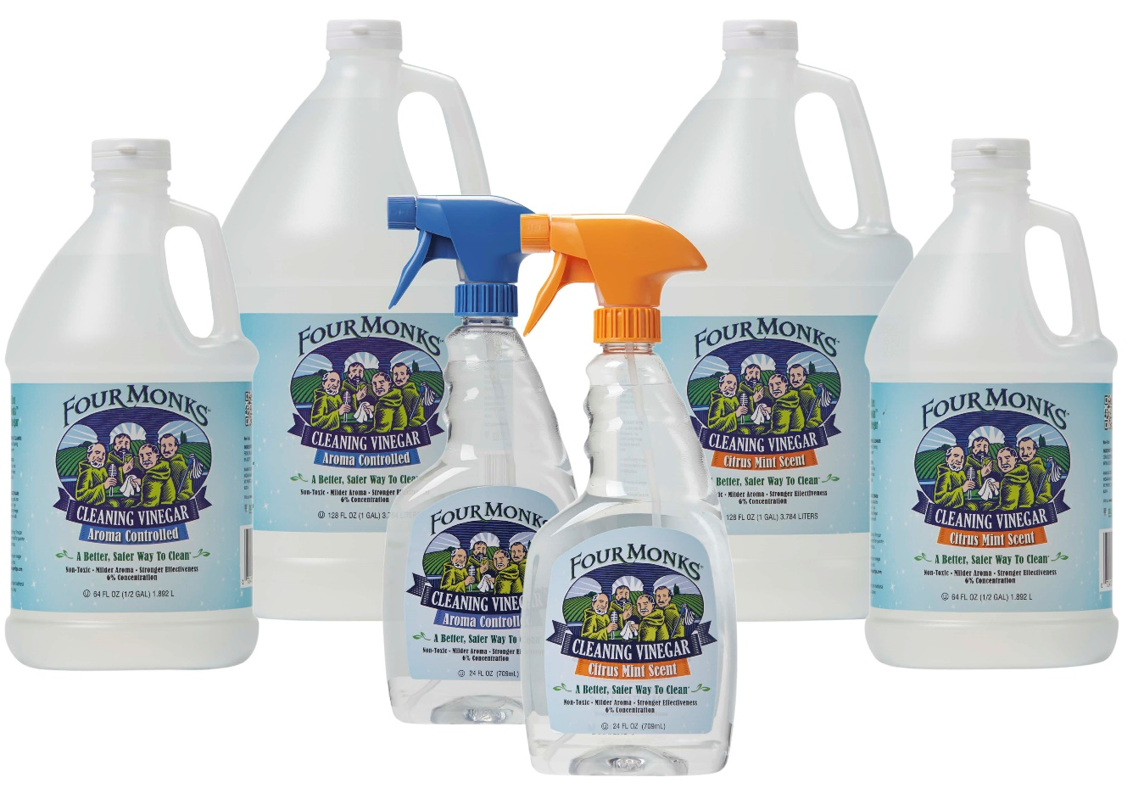
Situational Analysis: FOUR MONKS
Current formulation is 6% white distilled vinegar with a scent applied (citrus mint) or natural vinegar scent (aroma controlled).
Each scent is sold in three bottle sizes & shapes:
24oz spray
64oz
128oz
These 6 SKUs total $1.1M in gross sales at a 15% margin
Accounts: Walmart, HEB, and C&S
28

Slide 9

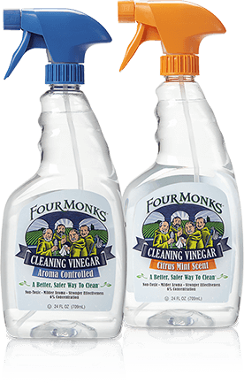







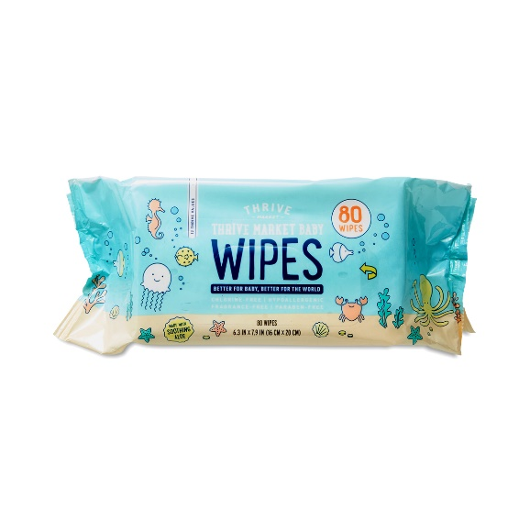

Goal
28

Slide 10
New Product Outcomes
Relaunch as new Product Portfolio under Four Monks Brand
Full brand relaunch with new skus and new scents
Product Mix
Four 24oz scents
Four 16oz Scents
Two Wipes Scents
Two 64oz Scents
Two 128oz Scents
Brand Attributes
Organic or Non-GMO
Efficacy (kills 99.9%)
Safe for Kids and Pets
Recycled material or Recyclable Materials
New Bottle Shapes
New Packaging Graphics
New Competitive Comparisons
Margin Target: 25% GM
$1.2MM Incremental Net Sales
Need to Develop:
New P&L
Volume/Financial Model
Pricing Strategy
28

Slide 11
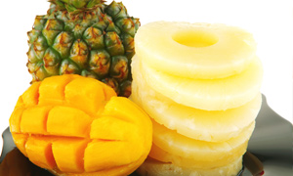
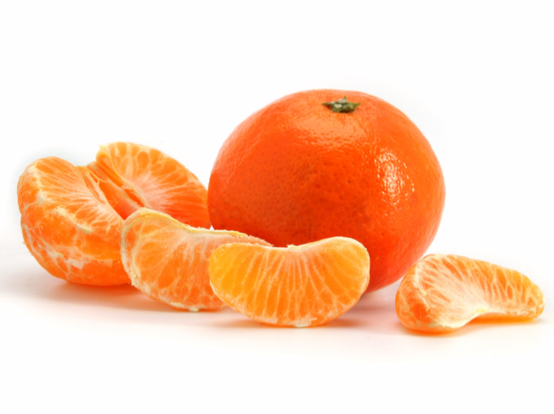

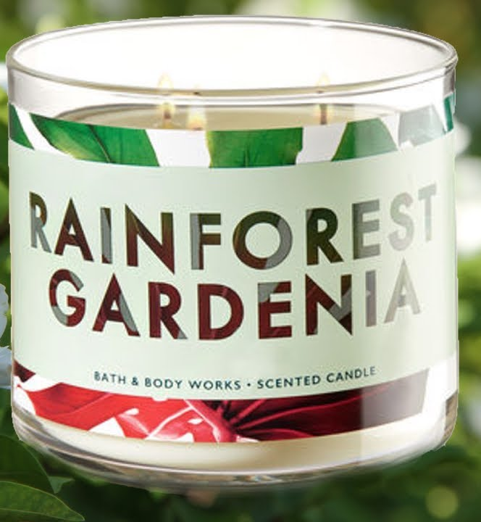
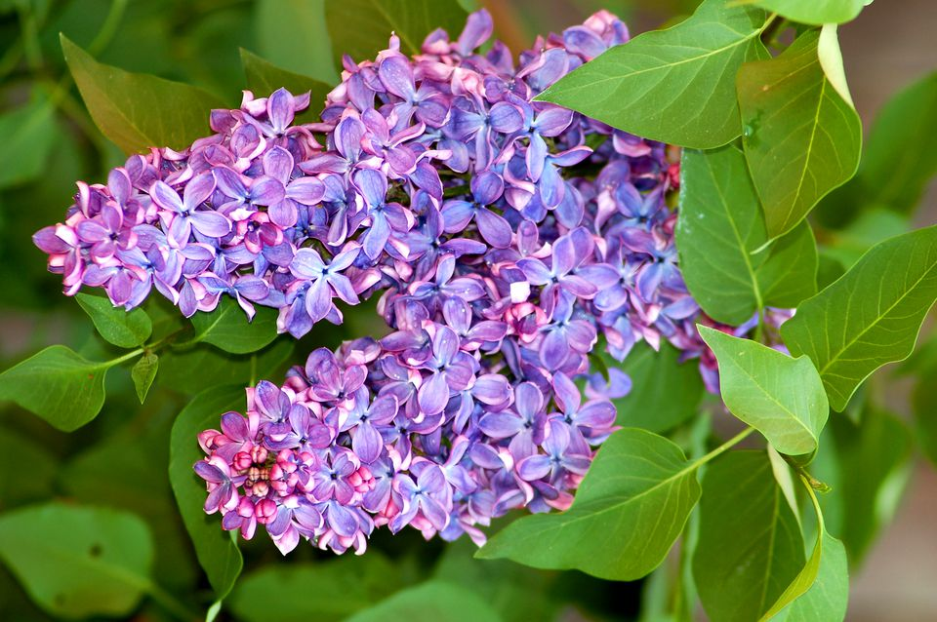


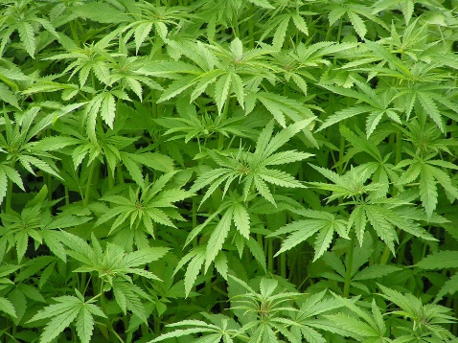
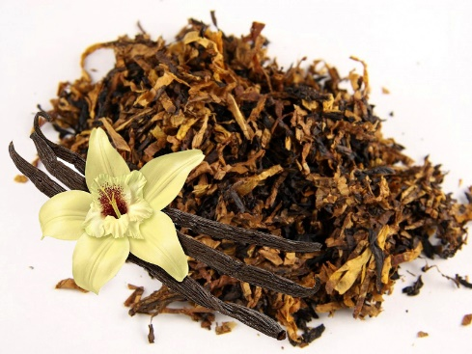
Four Monks – New Scents & Sizes
Scent exploration across four scent categories:
Citrus
Clementine
Pineapple Mango
Beach Coconut
Floral
Lilac
Rainforest Gardena
Rosewater & Ivy
Woody
Eucalyptus Mint
Tobacco & Vanilla
Hemp
Other
None – No Scent
28

Slide 12

NEW Four Monks – Validation
Internal CLT #1 (May)
All Scents
Top Bottle Shapes
Internal CLT #2 (June)
Top Scent each vertical
Top Bottle Shape/Packaging Graphics
External Confirmatory (July)
Refined Top Scent Each Vertical
Refined Packaging Graphics
28

Slide 13
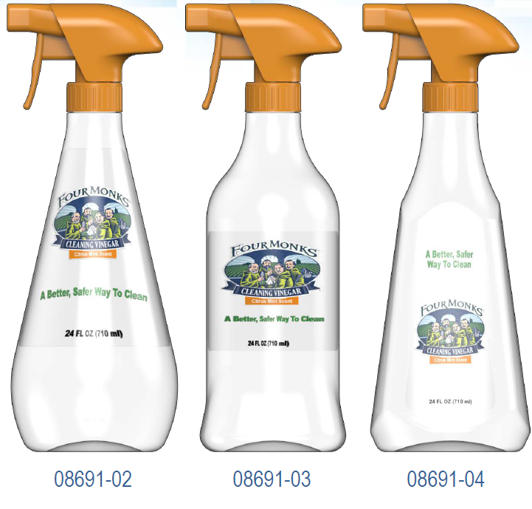
NEW Four Monks – Bottle Options
The Four Monks bottle is also being redesigned for three reasons:
Competitors in the sub-category have unique bottles, which help them stand out.
It reinvigorates the brand and differentiates us in the category and from our earlier SKUs.
The old bottle looked like an old style Windex bottle and did not give us correct positioning in the category.
To the left are the three front-runners for our bottle redesign.
28

Slide 14




NEW Four Monks – Sales Implications
We will continue serving our customer without interruption.
Current customers will continue buying current formulas until they have a review to sell-in the new formula.
This will be a soft transition.
All current inventory will be worked through.
The first presentation of the new formula will be to KeHe in October, with a February set.
Sale samples will be available but finished goods will not be available until closer to the set date.
28

Slide 15
Next Steps
Packaging
Acquire bottle sample.
Once bottles options are chosen then packaging and corrugates can be created.
Coman
Selected bottle samples will be sent to the coman to run fill and packaging tests.
Labeling
Once bottle options are identified, we will work with our design partners to create packaging graphics.
CLTs
Two internal CLTs will be conducted across May and June.
One confirmatory CLT will be run in July to verify the results of our two internal CLTs.
28

Slide 16
NEW Four Monks – Quick Update
New Sales Implications:
We will be focusing on launching the new formula and bottle at existing retailers – Primarily Walmart, HEB, & our distributors.
Reviews for HEB & Walmart will be scheduled once development is complete. We will not have to wait for a yearly review, which was previously assumed.
This will still be a soft transition.
The above changes do not affect the completion timeline.
Refined Bottle & Scent Options:
24oz will be the only spray size. Wipes will have one size, 33 count. Gallon and half-gallon remain unchanged.
Three total scents will be developed instead of four: clementine, lilac, & no scent.
All three scents will be available in Spray bottles; one scent will be available for wipes, and 2 for the gallon/half gallon.
EPA:
EPA costing looks to be much lower than expected. Looking to be in the $5,000 to $10,000 range.
CLTs:
No confirmatory external CLT will be able to be performed. All CLTs will be internal.

